Slide 1

COMPUTER NETWORKS INDUSTRY PROBLEM II DHCP RFC-2131
RFC READING
BY: GAURAV MAHAJAN
SEM 4-C
SRN: PES1UG20CS150

Slide 2
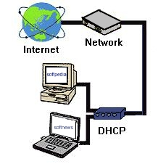
HISTORY
DHCP was created by the Dynamic Host Configuration Working Group of the Internet Engineering Task Force
October 1993: RFC 1531 initially defined DHCP as a standard-track protocol succeeding the Bootstrap Protocol (BOOTP), which is a network protocol used by a network client to obtain an IP address from a configuration server
October 1997: RFC 2131 released is the current DHCP definition for Internet Protocol version 4 (IPv4) networks
The extensions of DHCP for IPv6 (DHCPv6) were published as RFC 3315

Slide 3


INTRODUCTION
The protocol chosen is :-DHCP
It stands for Dynamic Host Configuration Protocol.
It is present in RFC schedule 2131.
the dynamic host configuration protocol (DHCP) provides configuration parameters to internet hosts.
DHCP is built on a client-server model, where designated DHCP server hosts allocate network addresses and deliver configuration parameters to dynamically configured hosts.

Slide 4
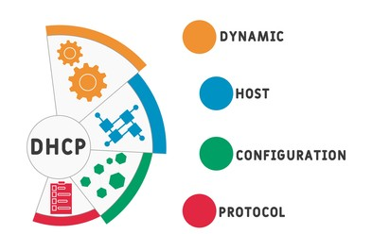
INTRODUCTION
DHCP consists of two components:
→a protocol for delivering host-specific configuration parameters from a
DHCP server to a host and
→a mechanism for allocation of network addresses to hosts.

Slide 5
PURPOSE
To automate the process of configuring devices on IP networks.
Thus allowing them to use network services such as DNS, NTP, and any communication protocol based on UDP or TCP.
A DHCP server dynamically assigns an IP address and other network configuration parameters to each device on a network so they can communicate with other IP networks.
DHCP is an important part of the DDI SOLUTION(DNS-DHCP-IPAM).
Operation tasks are reduced: the network administrator no longer needs to manually configure each client before it can use the network
The IP addressing plan is optimized: addresses no longer being used are freed up and made available to new clients connecting
User mobility is easily managed: the administrator doesn’t need to manually reconfigure a client when its network access point changes.

Slide 6

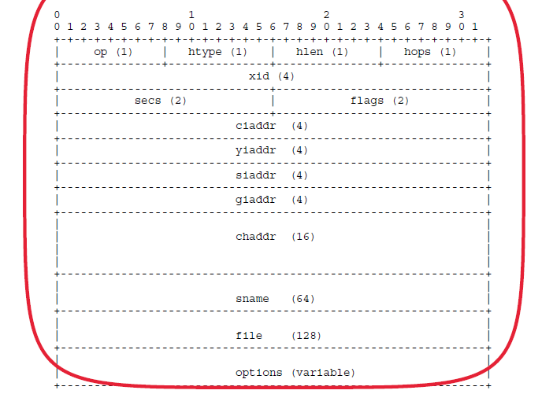
MESSAGE FORMAT

Slide 7
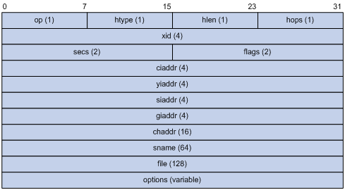
MESSAGE FORMAT
op = Opcode (message code/type)-1 Byte
htype = Hardware Address type-1Byte
hlen = Hardware address length – 1 Byte
hops = Client sets to zero, optionally used by relay agents when booting via a relay agent – 1 Byte
xid = Transaction ID, a random number chosen by the client, used by the client and server to associate messages and responses between a client and a server – 4 Bytes
secs = Filled in by client, seconds elapsed since client began address acquisition or renewal process - 2 Bytes

Slide 8
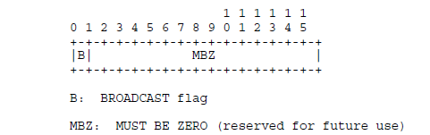
MESSAGE FORMAT
flags = flag values – 2 Bytes
ciaddr = Client IP address – 4 Bytes; only filled in if client is in BOUND, RENEW or REBINDING state and can respond to ARP requests.
yiaddr = ’your’ (client) IP address – 4 Bytes
siaddr = IP address of next server to use in bootstrap – 4 Bytes
giaddr = Relay agent IP address, used in booting via a relay agent – 4 Bytes
chaddr = Client hardware address – 16 Bytes

Slide 9
MESSAGE FORMAT
sname = Optional server host name, null terminated string - 64 Bytes
file = name or null in DHCPDISCOVER, fully qualified directory-path name in DHCPOFFER -128 Bytes
options = Optional parameters field – variable length

Slide 10
USAGE 1.DHCP AS A CONFIGURATION PARAMETERS REPOSITORY
SERVER END
The first service provided by DHCP is to provide persistent storage of network parameters for network clients. The model of DHCP persistent storage is that the DHCP service stores a key-value entry for each client, where the key is some unique identifier. and the value contains the configuration parameters for the client.
the key might be the pair (IP-subnet-number, hardware address)allowing for serial or concurrent reuse of a hardware address on different subnets.
the key might be the pair (IP-subnet-number, hostname), allowing the server to assign parameters intelligently to a DHCP client that has been moved to a different subnet or has changed hardware addresses.

Slide 11
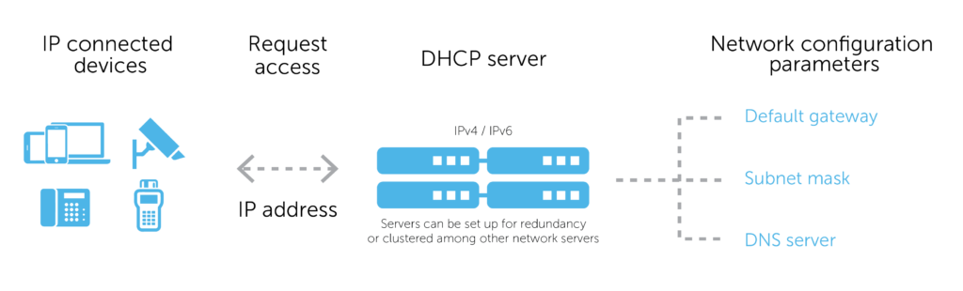
1.DHCP AS A CONFIGURATION PARAMETERS REPOSITORY
CLIENT SIDE
The client interface to the configuration parameters repository consists of protocol messages to request configuration parameters and responses from the server carrying the configuration parameters.

Slide 12
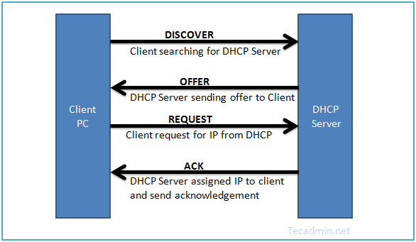
Usage ii. dynamic allocation of network addresses
DHCP DISCOVER
The client broadcasts a DHCPDISCOVER message on its local physical subnet. The DHCPDISCOVER message MAY include options that suggest values for the network address and lease duration. BOOTP relay agents may pass the message on to DHCP servers not on the same physical subnet.

Slide 13
ii. dynamic allocation of network addresses
DHCP OFFER
Each server may respond with a DHCPOFFER message that includes an available network address in the ’yiaddr’ field. Servers need not reserve the offered network address, although the protocol will work more efficiently if the server avoids allocating the offered network address to another client. When allocating a new address, servers SHOULD check that the offered network address is not already in use The server transmits the DHCPOFFER message to the client, using the BOOTP relay agent if necessary.

Slide 14
ii. dynamic allocation of network addresses
DHCP REQUEST
The client receives one or more DHCPOFFER messages from one or more servers. The client may choose to wait for multiple responses. The client broadcasts a DHCPREQUEST message that MUST include the ’server identifier’ option to indicate which server it has selected, and that MAY include other options specifying desired configuration values. The ’requested IP address’ option MUST be set to the value of ’yiaddr’ in the DHCPOFFER message from the server. This DHCPREQUEST message is broadcast and relayed through DHCP/BOOTP relay agents.

Slide 15
ii. dynamic allocation of network addresses
DHCP ACK
The server selected in the DHCPREQUEST message commits the binding for the client to persistent storage and responds with a DHCPACK message containing the configuration parameters for the requesting client. The combination of ’client identifier’ or ’chaddr’ and assigned network address constitute a unique identifier for the client’s lease and are used by both the client and server to identify a lease referred to in any DHCP messages. Any configuration parameters in the DHCPACK message SHOULD NOT conflict with those in the earlier DHCPOFFER message to which the client is responding. The client receives the DHCPACK message with configuration parameters. At this point, the client is configured.

Slide 16
conclusion
DISADVANTAGES
➨DHCP server can be single point of failure in networks having only one configured DHCP server. ➨DHCP packets can not travel across router, Hence relay agent is necessary to have DHCP server handle all leases on both network segments. Relay agents receive broadcast DHCP packets and forward them as unicast packets to DHCP server. Here relay agent must be configured with IP address of the DHCP server. ➨Security: As DHCP server has no secure mechanism for authentication of the client, it can gain unauthorized access to IP addresses by presenting credentials such as client identifiers which belong to other DHCP clients. ➨The machine name does not change when new IP address is assigned. ➨Client is not able to access the network in the absence of the DHCP server.
ADVANTAGES
➨ DHCP is easy to implement and does automatic assignment of IP addresses to requesting clients. Hence manual configuration time of IP addresses can be reduced. ➨The implementation does not require any additional costs. ➨Duplicate or invalid assignment of IP addresses are prevented. Hence there is no chance of conflicts in IP addresses. ➨It simplifies administration of the network. ➨It supports multiple scopes e.g. multicast scope, super scope etc. ➨It has great benefit to mobile users as valid configuration parameters are automatically obtained from the new network

Slide 17


SPECIAL ThankS TO:
PROF.ASHWINI M JOSHI

